Slide 1
Portfolio management
Ishara Raviharee Weerasinghe

Slide 2



Slide 3
What are the uses of a portfolio
Job Applications: Portfolios are often used to supplement resumes and showcase work samples, projects, and achievements that demonstrate a candidate's qualifications and skills.
Career Advancement: Professionals can use portfolios to present their accomplishments, skills, and experiences when seeking promotions, raises, or new opportunities within their current organization.
Creative Industries: Artists, designers, writers, and photographers use portfolios to display their creative work and demonstrate their style, skills, and capabilities to potential clients or employers.
Educational Assessments: Students use portfolios to document their learning progress, assignments, and projects over time. These portfolios provide evidence of their academic growth and achievements.
Educational Admissions: Portfolios are often submitted as part of college or university applications to showcase extracurricular activities, community involvement, and unique talents.
Teaching and Education: Educators compile teaching materials, lesson plans, student work, and reflections in a portfolio to showcase their teaching effectiveness and professional development.

Slide 4
Uses of Portfolio Cont..
Freelancing and Consulting: Freelancers and consultants use portfolios to display their range of services, previous projects, and client testimonials to attract new clients.
Professional Development: Portfolios can track ongoing professional development, including certifications, workshops, conferences attended, and skills acquired.
Performance Evaluation: In workplace evaluations, employees and managers can use portfolios to assess an individual's performance and contributions to the team or organization.
Skill Demonstrations: Portfolios can be used to demonstrate specific skills, such as coding, graphic design, public speaking, project management, or leadership.
Entrepreneurship: Entrepreneurs can use portfolios to showcase their business plans, products, services, and strategies to potential investors or partners.
Evidence of Competence: Portfolios provide tangible evidence of competence, whether in terms of technical skills, soft skills, leadership abilities, or specific accomplishments.
Networking: Portfolios can serve as conversation starters during networking events and professional gatherings, allowing individuals to share their achievements and experiences.
Personal Branding: A well-curated portfolio helps individuals establish a strong personal brand, highlighting their strengths, values, and unique qualities.
Career Transition: When switching careers, portfolios can emphasize transferable skills and relevant experiences that make candidates attractive to employers in their new field.

Slide 5
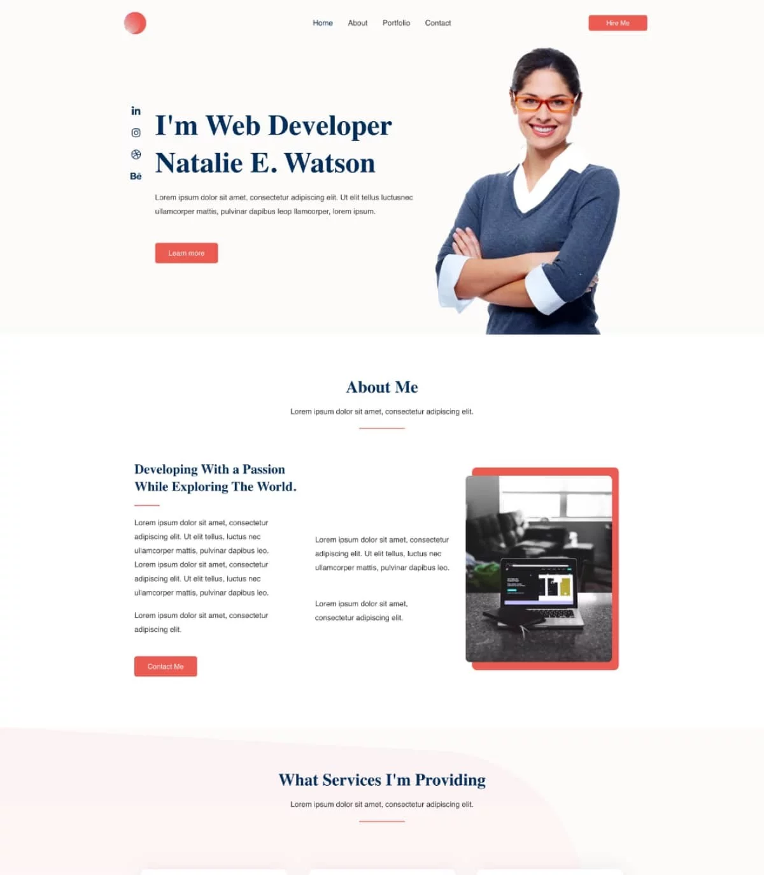
1. Personal Portfolio
A personal portfolio is a collection of your creative work, achievements, and projects that showcase your skills, talents, and interests.
It's often used by individuals in creative fields such as art, design, photography, writing, and multimedia.
Personal portfolios provide a platform to express your unique style and creative abilities.

Slide 6
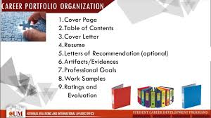
2. Career/Dossier Portfolio:
A career or dossier portfolio is designed to present your professional achievements and credentials.
It typically includes your resume, cover letter, reference letters, and documentation of your work experience.
This type of portfolio is commonly used when applying for jobs, promotions, or educational opportunities.

Slide 7
3. Employment Portfolio:
An employment portfolio is a comprehensive collection of your work-related documents, accomplishments, and evidence of skills.
It may include work samples, performance evaluations, training certificates, and examples of how you've contributed to your workplace's success.
Employment portfolios are used to demonstrate your value as an employee and to support career development discussions.

Slide 8
4. Assessment Portfolio
An assessment portfolio is used to showcase your learning progress, growth, and achievements over a period of time.
It's often utilized in educational settings, where students compile their work, projects, and assignments to demonstrate their understanding of specific subjects or skills.
Assessment portfolios help educators and learners evaluate academic progress and development.

Slide 9
Assessment Portfolio
1. Define Your Purpose:
Determine the primary purpose of your assessment portfolio. Is it for academic purposes, job applications, personal development, or a combination of these?
2. Identify Your Audience:
Consider who will be reviewing your portfolio. Tailor the content and presentation to meet their expectations and requirements

Slide 10
3. Choose Your Format:
Decide on the format of your portfolio. It can be physical (a printed binder) or digital (a website, PDF, or online platform). Digital portfolios are often more versatile and accessible.
4. Collect Your Materials:
Gather relevant documents, artifacts, and evidence of your skills and accomplishments. These can include:
Academic transcripts and certificates
Resume/CV
Writing samples
Work projects and reports
Awards and recognition
Letters of recommendation
Certifications and licenses
Artwork, photos, or other creative work

Slide 11
5. Organize Your Portfolio:
Structure your portfolio logically with clear sections and headings. Common sections include:
Introduction (cover letter or personal statement)
Resume or CV
Educational achievements
Work experience
Projects and assignments
Certifications and skills
References or testimonials
Reflective statements (self-assessment and goals)
Table of contents (for easy navigation)
6. Provide Context:
For each item in your portfolio, provide context and explain its significance. Explain why it's included and what you learned or achieved from it.

Slide 12
7. Showcase Your Achievements:
Highlight your accomplishments, skills, and experiences that are relevant to your goals. Use quantifiable results and specific examples whenever possible.
8. Maintain a Professional Appearance:
Ensure that your portfolio is well-organized, error-free, and visually appealing. Use a consistent formatting style (font, color, headings) throughout.
9. Include Self-Assessment:
Reflect on your strengths, weaknesses, and areas for improvement. Share your personal growth and learning experiences.

Slide 13
10. Regularly Update Your Portfolio: - Keep your assessment portfolio up-to-date with new achievements and experiences as they occur.
11. Seek Feedback: - Ask peers, mentors, or advisors for feedback on your portfolio's content and presentation. Make improvements based on their suggestions.
12. Tailor Your Portfolio: - Customize your portfolio for different purposes or audiences. Highlight specific skills or experiences that align with the requirements of a particular job or educational program.
13. Practice Presenting Your Portfolio: - If you're asked to present your portfolio in person or virtually, practice your presentation skills. Be ready to discuss the content and answer questions.

Slide 14
14. Keep Copies and Backups: - Maintain both digital and physical copies of your portfolio. Regularly back up digital versions to prevent loss.
15. Protect Your Privacy: - Be mindful of including sensitive personal information. Share only what is necessary for your intended purpose.
16. Use Technology Wisely: - If you choose to create a digital portfolio, explore various tools and platforms to make your portfolio interactive and engaging.
17. Continuously Learn and Improve: - As you progress in your education or career, continue to update and refine your assessment portfolio. Use it as a tool for self-assessment and professional development.

Slide 15
What online sources are available to create portfolios?
LinkedIn:
LinkedIn is a popular professional networking platform that allows you to create an online profile, showcase your work experience, education, skills, and even share multimedia content like articles and presentations.
Behance:
Behance is a platform designed for creative professionals. It allows you to build an online portfolio to showcase your graphic design, photography, illustration, and other creative work.
Google Sites:
Google Sites is a free and user-friendly website builder that integrates seamlessly with Google Drive. You can create a simple website to display your portfolio, including text, images, and links.
WordPress:
WordPress is a versatile content management system (CMS) that allows you to create a customized website or blog. Many themes and plugins are available to help you build an interactive portfolio.
Wix:
Wix is a popular website builder with a user-friendly drag-and-drop interface. It offers a range of templates and features for building a professional portfolio website.

Slide 16
Weebly:
Weebly is another easy-to-use website builder that offers various templates and design options. It's suitable for creating a portfolio website with minimal technical knowledge.
Squarespace:
Squarespace is known for its elegant and visually appealing website templates. It's a great choice if you want a stylish portfolio site with minimal design effort.
Adobe Portfolio:
Adobe Portfolio is a platform that integrates with Adobe Creative Cloud. It's ideal for creative professionals and allows you to easily showcase your work with Adobe applications like Photoshop and Illustrator.
GitHub Pages:
If you are a programmer or software developer, GitHub Pages is an excellent option. It lets you host a static website for free, making it suitable for displaying coding projects and open-source contributions.

Slide 17
Cargo:
Cargo is a platform designed for artists and creative professionals. It offers customizable templates and a straightforward interface for creating visually stunning portfolios.
Portfoliobox:
Portfoliobox is a portfolio website builder that caters to artists, designers, and photographers. It provides tools for creating and customizing your portfolio website.
Journo Portfolio:
Journo Portfolio is designed for writers and journalists. It allows you to build a writing portfolio with ease, showcasing your articles and blog posts.
Pathbrite:
Pathbrite is an e-portfolio platform designed for educational and career purposes. It enables students and professionals to create multimedia-rich portfolios

